Slide 1
Introduction to Mapping APIs
Lecturer: Ms. Aneeqa Abrar
Email: aneeqa.abrar@gmail.com

Slide 2
Table of Content
Introducing Mapping APIs
Let’s Start Coding!

Slide 3
Introducing Mapping APIs

Slide 4
Introducing Mapping APIs
OpenLayers
Google Maps
Leaflet
Cesium JS

Slide 5

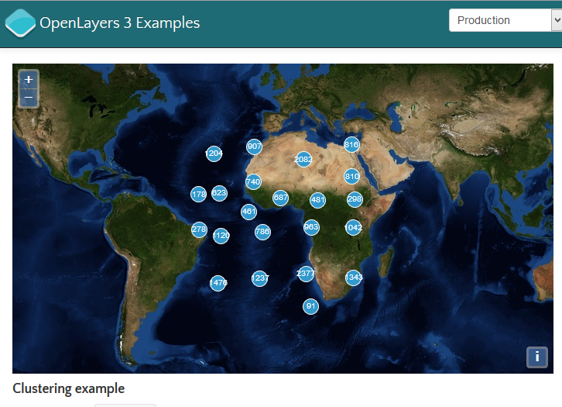
OpenLayers
Object-oriented JavaScript library version 2+ 3
OL 2.X using Prototype.js and Rico library)
OL 3 using Google’s Closure Tools (compiler+ library)
Lets you add maps to any web page by embedding OpenLayer.js
no server-side dependencies
Easily reusable component similar to Google Maps and BING Web Mapping APIs
Input Formats
Bing, Open Street map, Google Maps, WMS, Vector layers, GeoRSS, WFS, KML
Standard Tools
Google Like zoom bar, standard functions like zoom in/out pan

Slide 6

Google Maps
The Google Maps JavaScript API lets you embed Google Maps in your app
The latest version (v3) of this API is especially designed to be faster and more applicable to mobile devices
The API provides a number of utilities for manipulating maps and adding content to the map through a variety of services
Available both as free and paid services

Slide 7

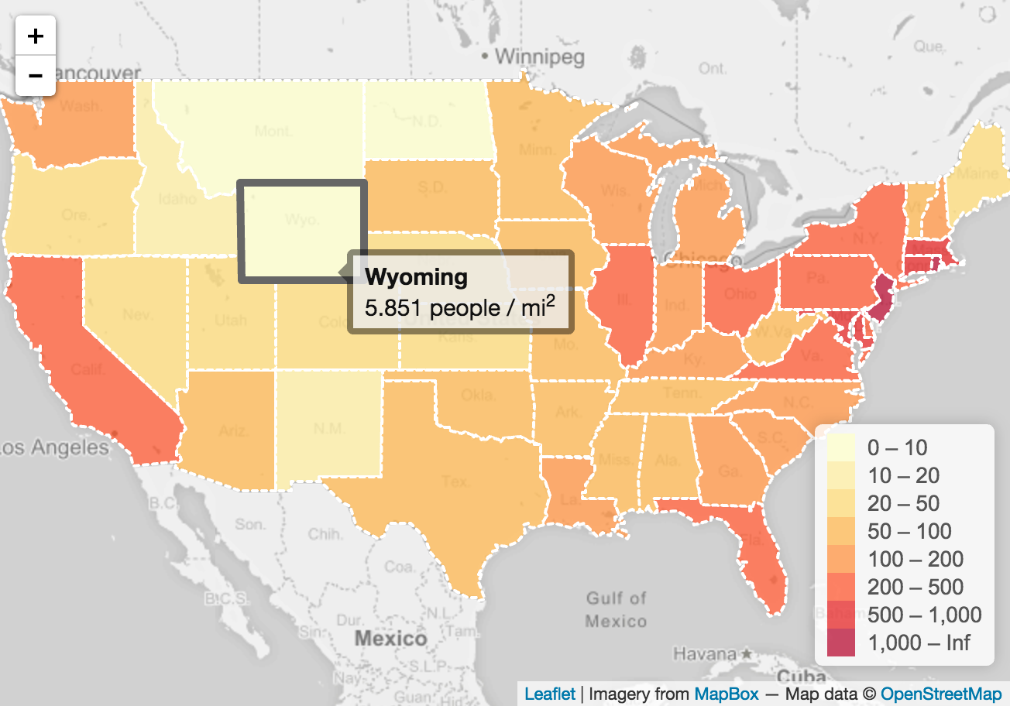
Leaflet
A popular, lightweight (38 kb) JavaScript library
No external dependencies
Lots of features, plugins
Ideal for making mobile-friendly interactive maps
Can be used on all major desktop and mobile platforms
Uses JS, HTML5 and CSS

Slide 8

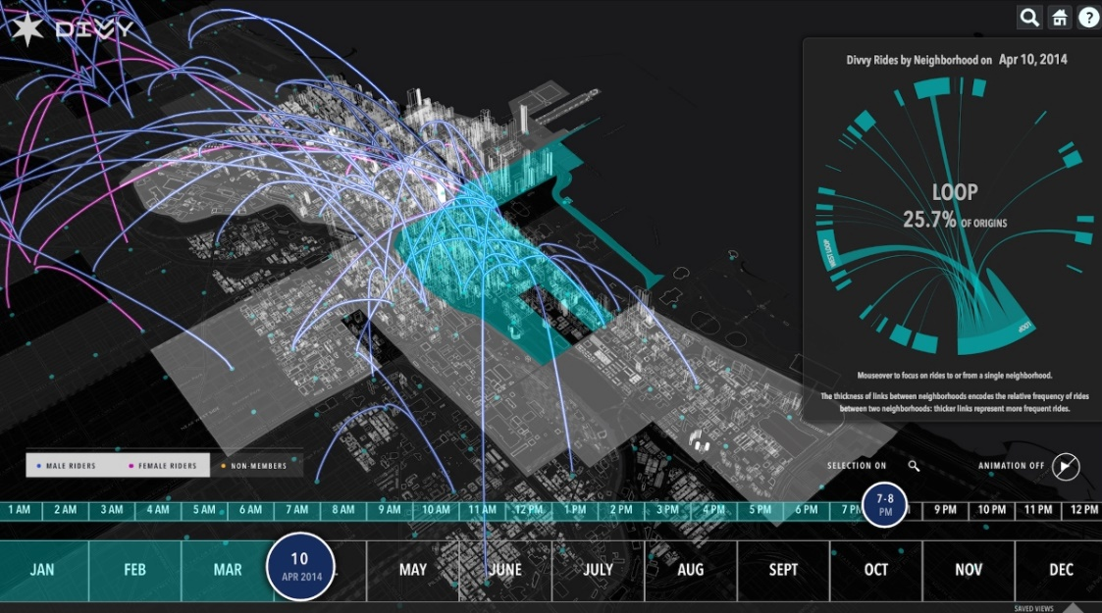
Cesium JS
An open-source JavaScript library for world-class 3D globes and maps in the browser
JavaScript Software with WebGL (Web Graphics Library) for displaying
3D virtual globe
2D map
2.5D Columbus View
Time-dynamic Scenes
Multiple terrain sources
Overlays :
Raster : WMS, TMS, OSM, Bing
Vector : glTF, CZML, KML, Shapefiles
Extensible with plugins

Slide 9
Let’s Start Coding!

Slide 10
Let’s Start Coding!
Preparing Page
Add a Map
Markers and Circles
Working with Popups
Dealing with Events
GeoJSON
Documentation & Plugins

Slide 11
Preparing Page
Leaflet CSS file in the head section:
Leaflet JavaScript after Leaflet’s CSS:
<link rel="stylesheet" href="https://unpkg.com/leaflet@1.4.0/dist/leaflet.css" integrity="sha512-puBpdR0798OZvTTbP4A8Ix/l+A4dHDD0DGqYW6RQ+9jxkRFclaxxQb/SJAWZfWAkuyeQUytO7+7N4QKrDh+drA==" crossorigin=""/>
<script src="https://unpkg.com/leaflet@1.4.0/dist/leaflet.js" integrity="sha512-QVftwZFqvtRNi0ZyCtsznlKSWOStnDORoefr1enyq5mVL4tmKB3S/EnC3rRJcxCPavG10IcrVGSmPh6Qw5lwrg==" crossorigin=""></script>

Slide 12
Div element with an id:
Ensure the map container has a defined height by setting it in CSS:
<div id="mapid"></div>
#mapid {
height: 500px;
width: 700px;
}

Slide 13
Add a Map
Lat/Long
Initial Zoom
Leaflet CSS file in the head section:
var mymap = L.map('mapid').setView([51.505, -0.09], 13);
L.tileLayer('https://{s}.tile.openstreetmap.org/{z}/{x}/{y}.png', {
attribution: '&copy; <a href="http://osm.org/copyright">OpenStreetMap</a> contributors',
maxZoom: 18,
minZoom: 10
}).addTo(mymap);
Title Server URL

Slide 14
Markers, Circles and Polygons
Add a Polygon:
Add a Marker:
Add a Circle:
var marker = L.marker([51.5, -0.09]).addTo(mymap);
var polygon = L.polygon([
[51.509, -0.08],
[51.503, -0.06],
[51.51, -0.047]
]).addTo(mymap);
var circle = L.circle([51.508, -0.11], {
color: 'red’,
fillColor: '#f03’,
fillOpacity: 0.5,
radius: 500
}).addTo(mymap);

Slide 15
Working with Popups
Default Popups
Custom Popups
marker.bindPopup("<b>Hello world!</b><br>I am a popup.").openPopup(); circle.bindPopup("I am a circle.");
polygon.bindPopup("I am a polygon.");
var popup = L.popup()
.setLatLng([51.5, -0.09])
.setContent("I am a standalone popup.")
.openOn(mymap);

Slide 16
Dealing with Events
A basic onClick event
function onMapClick(e) {
alert("You clicked the map at " + e.latlng);
}
mymap.on('click', onMapClick);

Slide 17
A customized event
var popup = L.popup();
function onMapClick(e) {
popup
.setLatLng(e.latlng)
.setContent("You clicked the map at " + e.latlng.toString()) .openOn(mymap);
}
mymap.on('click', onMapClick);

Slide 18
GeoJSON
GeoJSON is a format for encoding a variety of geographic data structures […]. A GeoJSON object may represent a region of space (a Geometry), a spatially bounded entity (a Feature), or a list of Features (a FeatureCollection). GeoJSON supports the following geometry types: Point, LineString, Polygon, MultiPoint, MultiLineString, MultiPolygon, and GeometryCollection. Features in GeoJSON contain a Geometry object and additional properties, and a FeatureCollection contains a list of Features.
L.geoJSON(geoJSON).addTo(mymap);

Slide 19
GeoJSON - Point
var geojsonFeature = {
"type": "Feature",
"properties": {
"name": "Coors Field",
"amenity": "Baseball Stadium",
"popupContent": "This is where the Rockies play!"
},
"geometry": {
"type": "Point",
"coordinates": [-104.99404, 39.75621]
}
};
L.geoJSON(geojsonFeature).addTo(mymap);

Slide 20
GeoJSON - Lines
var myLines = [{
"type": "LineString",
"coordinates": [[-100, 40], [-105, 45], [-110, 55]]
}, {
"type": "LineString",
"coordinates": [[-105, 40], [-110, 45], [-115, 55]]
}];
Add Style Add Layer
var myStyle = {
"color": "#ff7800",
"weight": 5,
"opacity": 0.65
};
L.geoJSON(myLines,(
style: myStyle
}).addTo(mymap);

Slide 21
GeoJSON - Polygon
var states = [{
"type": "Feature",
"properties": {"party": "Republican"},
"geometry": { "type": "Polygon",
"coordinates": [[ [-104.05, 48.99], [-97.22, 48.98], [-96.58, 45.94], [-104.03, 45.94], [-104.05, 48.99]
]]
}
}, {
"type": "Feature",
"properties": {"party": "Democrat"},
"geometry": { "type": "Polygon",
"coordinates": [[ [-109.05, 41.00], [-102.06, 40.99], [-102.03, 36.99], [-109.04, 36.99], [-109.05, 41.00]
]]
}
}];

Slide 22
L.geoJSON(states, {
style: function(feature) {
} switch (feature.properties.party) {
case 'Republican': return {color: "#ff0000"};
case 'Democrat': return {color: "#0000ff"};
}
}). addTo(mymap);

Slide 23
Documentation & Plugins
For more refer to the leaflet documentation:
https://leafletjs.com/reference-1.4.0.html
For plugins refer to:
https://leafletjs.com/plugins.html

Slide 24
Thank You!

